Slide 1
Preparing Students for Their Unknown Future
Session 3
May 12, 2020
Michael Soskil - @msoskil

Slide 2
Review of Key Points from Session #2
UN Sustainable Development Goals provide a framework for students to see how their passions intersect with global/local issues.
UN SDG and Classroom Connection Tools: Empatico, TeachSDGs, World’s Largest Lesson, Skype in the Classroom, Take Action Global Projects
Ethical dilemmas increase as technology increases complexity of issues. Education must adapt to prepare students for a complex world.
PBL and STEM – Project and Problem Based Learning offer a pedagogical solution to preparing students to be problem solvers.
Introduction to Design Thinking
Share in the chat any reflections from last session or anything you've already tried to impliment.

Slide 3
5 Clue Challenge TV Show
Will air in Northeastern Pennsylvania on WVIA this Thursday at 12:30
You can view (and use with your students): 5ClueChallenge.com

Slide 4
Review of Group Norms
Resources: bit.ly/Soskil-BOCES
Videos found here
Group norms:
Respect
Empathy
Confidentiality
Active Participation
Using Zoom
Raise your hand
Reactions
Chat
Twitter: @msoskil

Slide 5
Workshop Overview
Session 1
Define the systemic challenges of the 4th Industrial Revolution
Explore why empathy and shared humanity are more important than ever in 4IR
Resources/strategies for building relationships and shared humanity during remote teaching
Session 2
Finding purpose and power in times of crisis
Local vs. Global Problem solving – United Nations Sustainable Development Goals
Introduction to Design Thinking
Session 3
Applying what we’ve learned – Exploring Problems of Practice and Developing Solutions
Continue – Resources for remote teaching
Design Thinking – What is it, and how does it fit with my teaching goals?
Goal setting and moving into the unknown future.

Slide 7
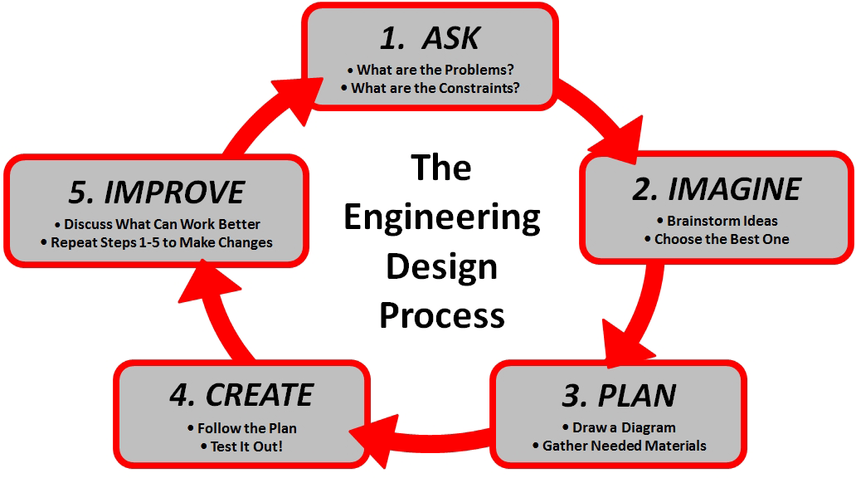
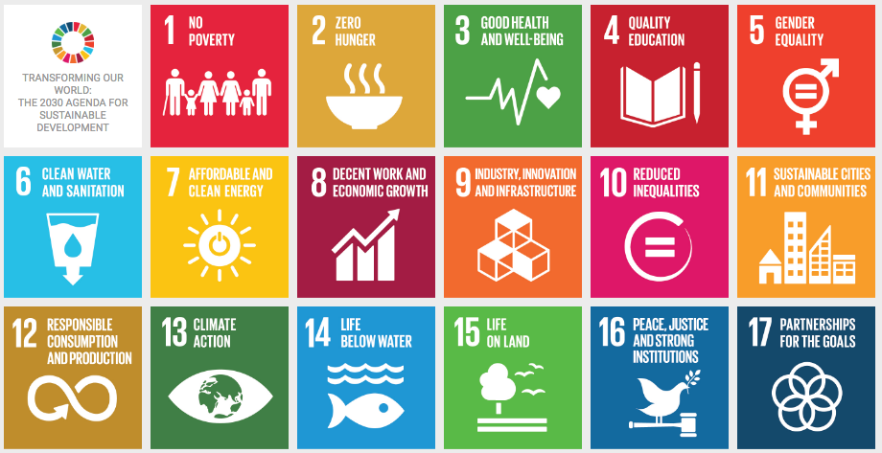
Design Thinking and United Nations SDGS
InnovationSDGlab.com/book
Notes:
----- Meeting Notes (10/23/16 18:05) -----
With that teaching philosophy, it's natural that the UN Sustainable Development Goals have been a focus in my career.
* NGO Advisor
*Almost every student's passion for making the world better can be tied to one of the UN SDGs.

Slide 10
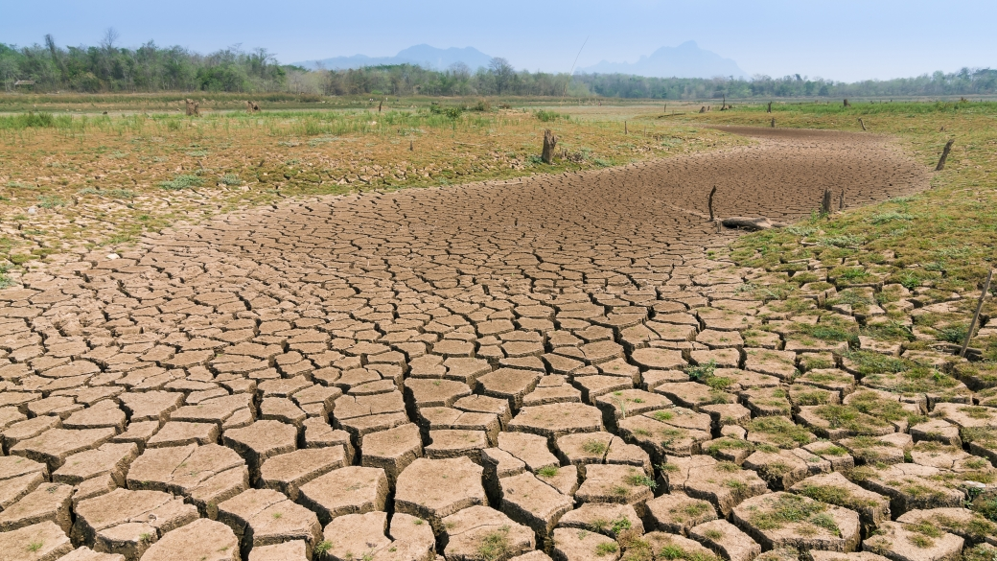

Slide 11
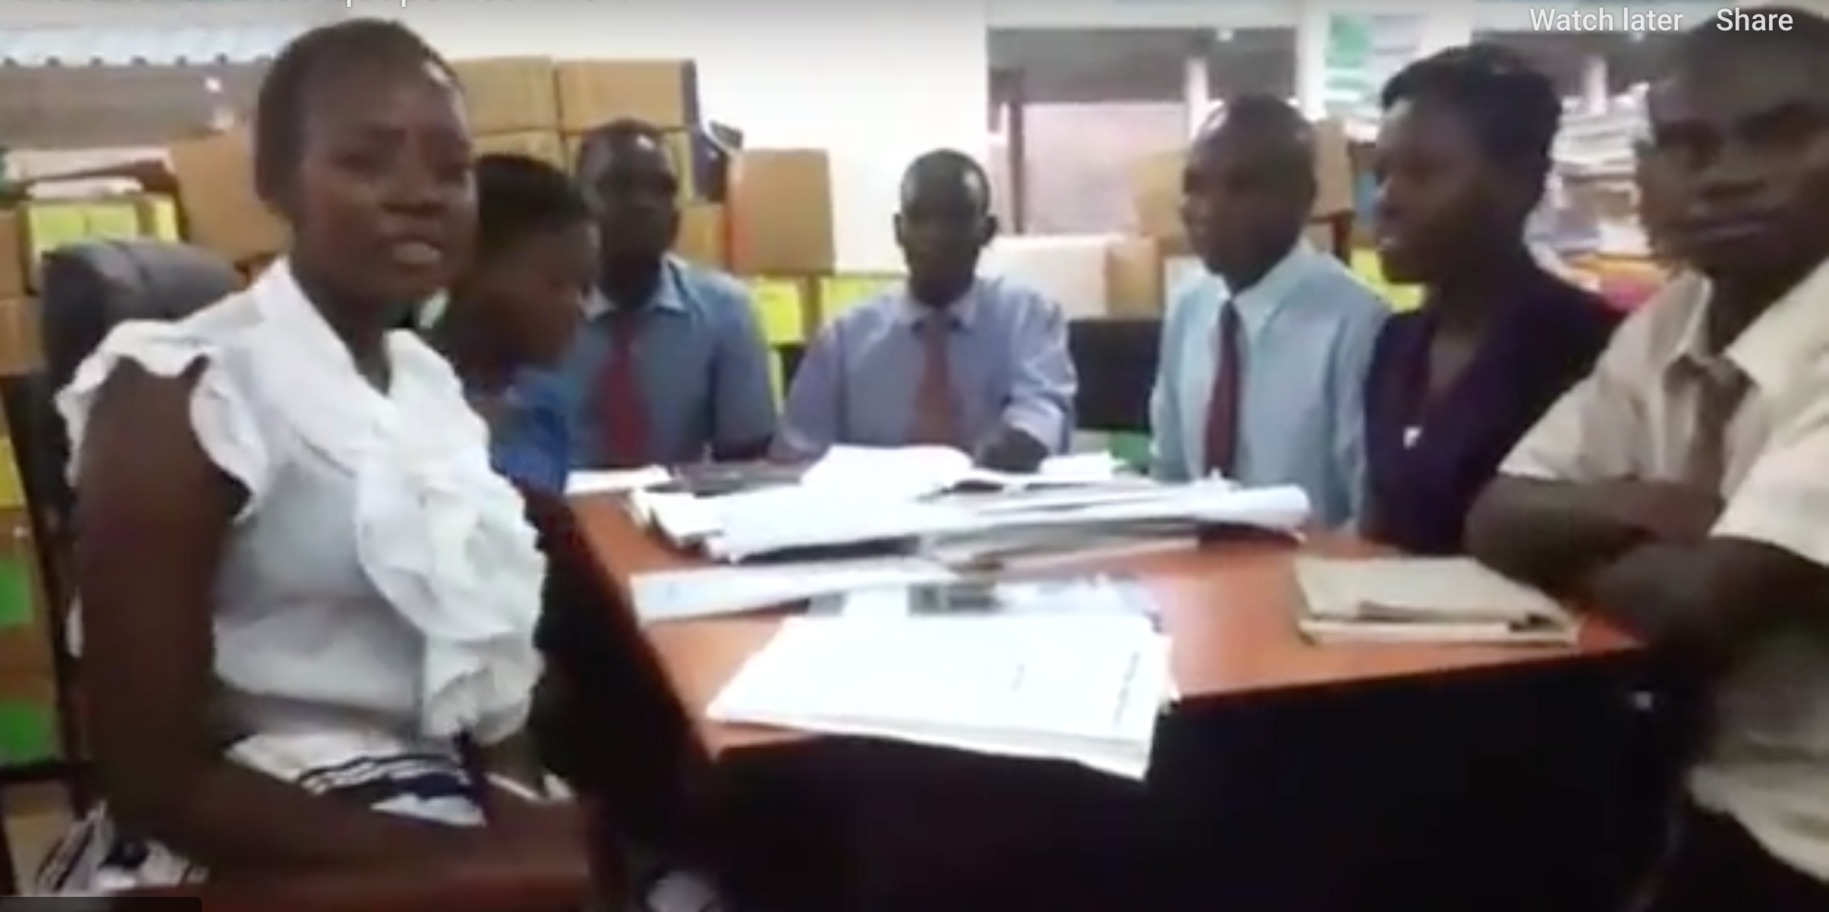

Slide 12
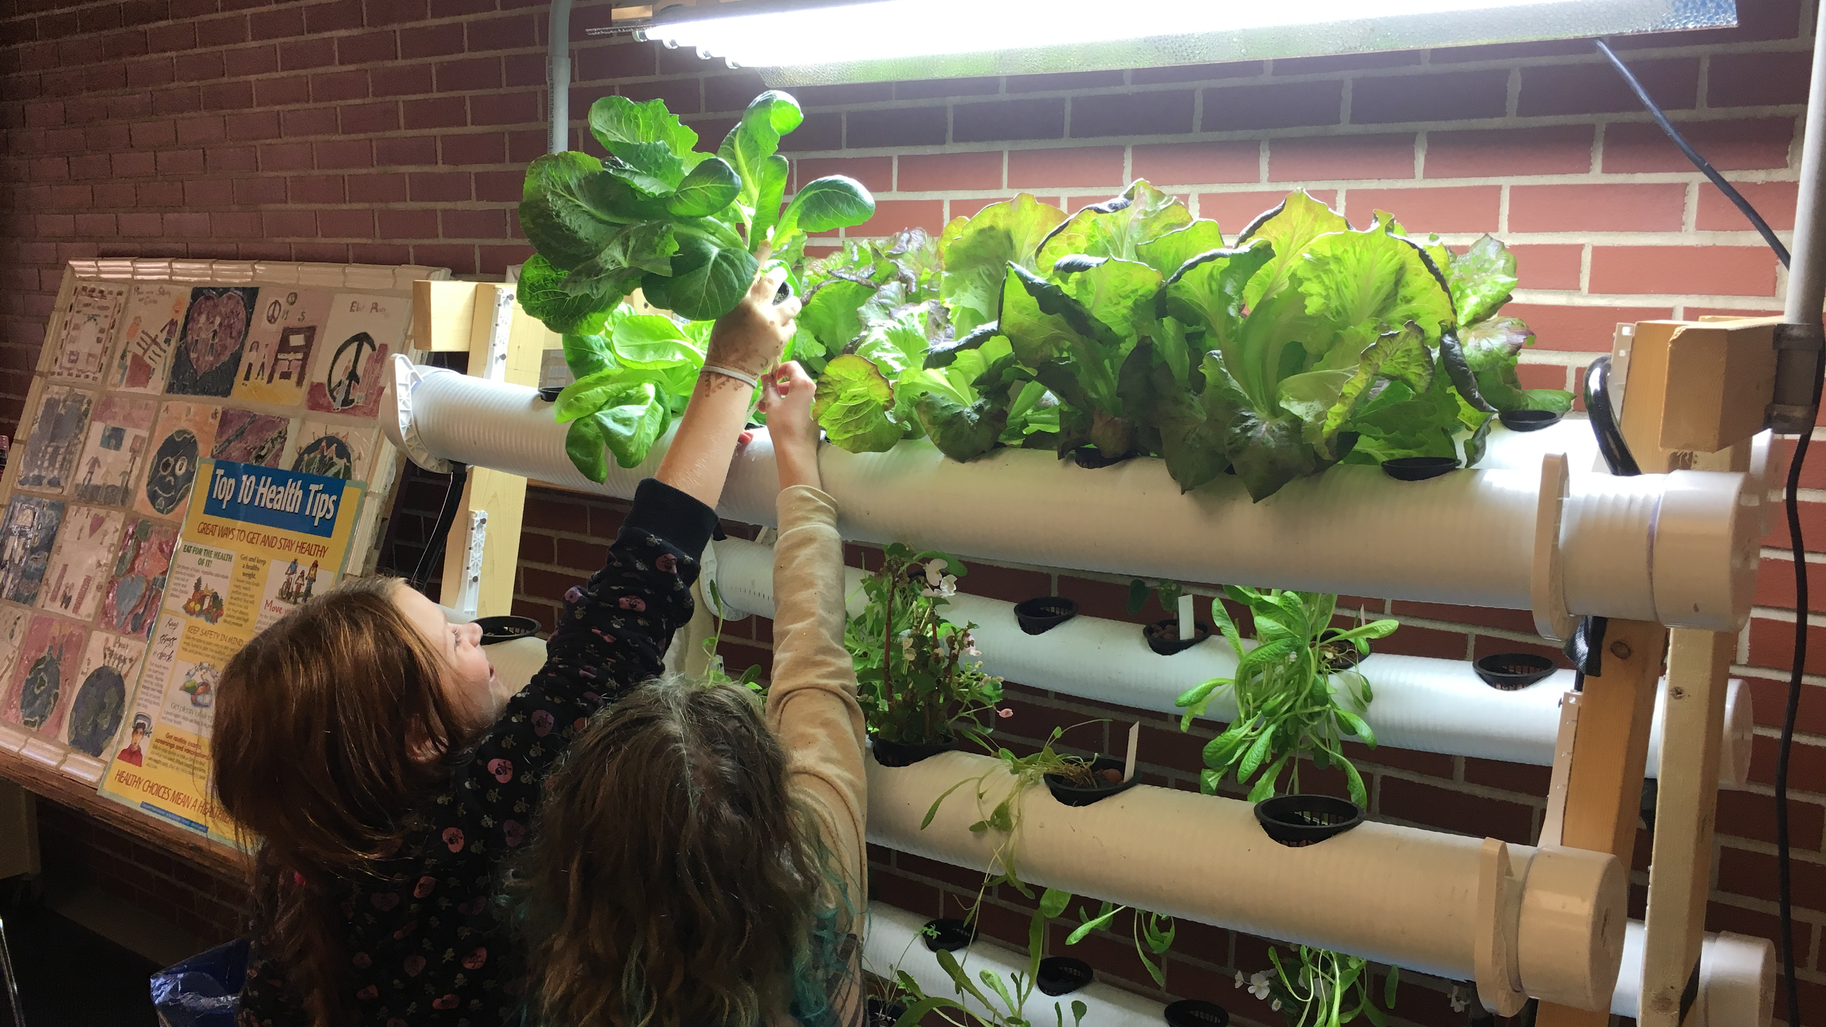

Slide 13
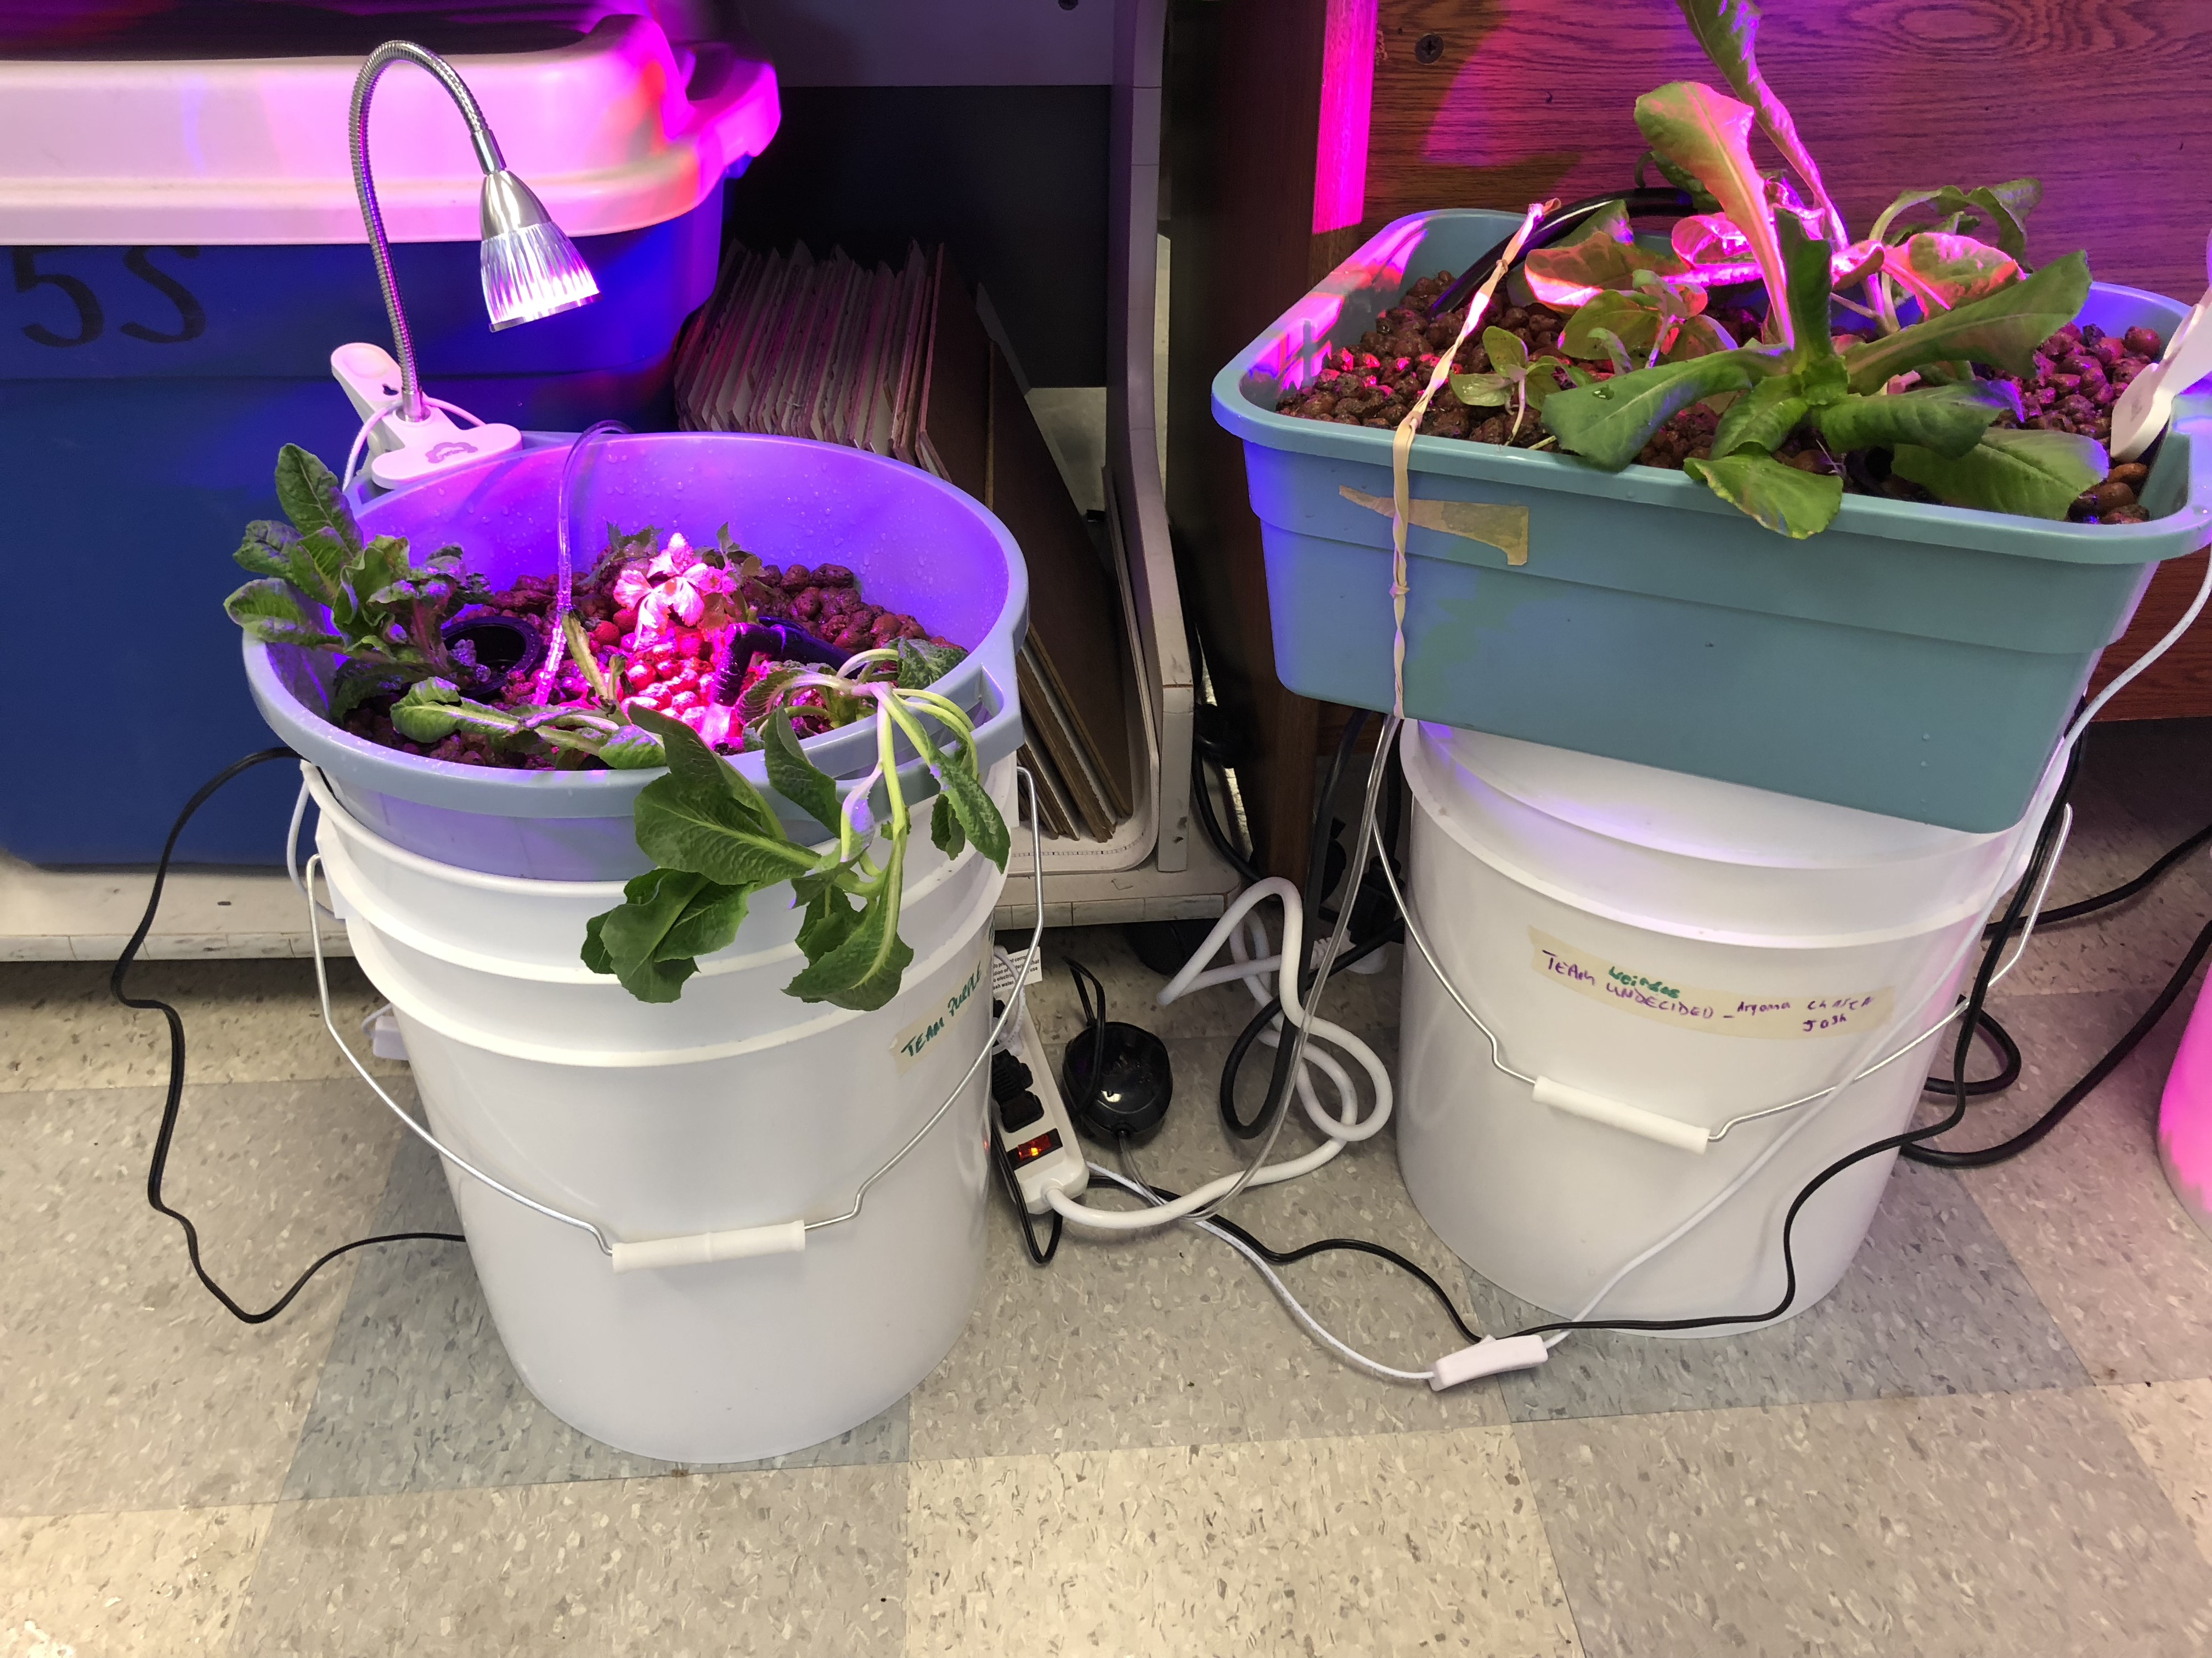

Slide 14
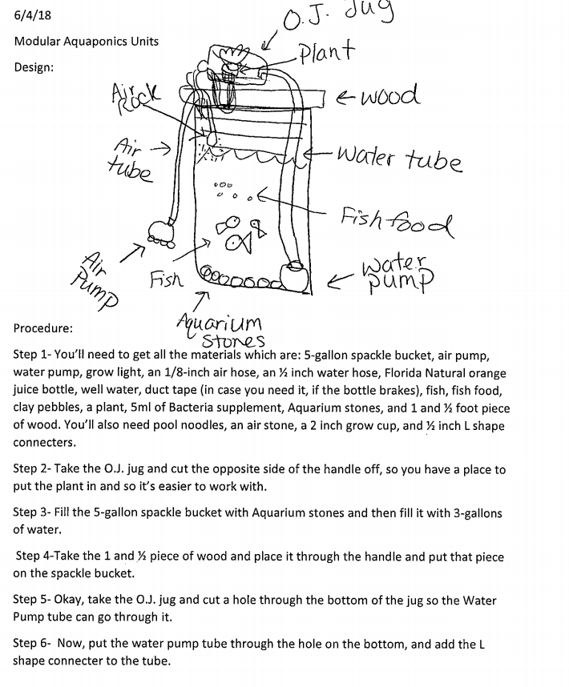
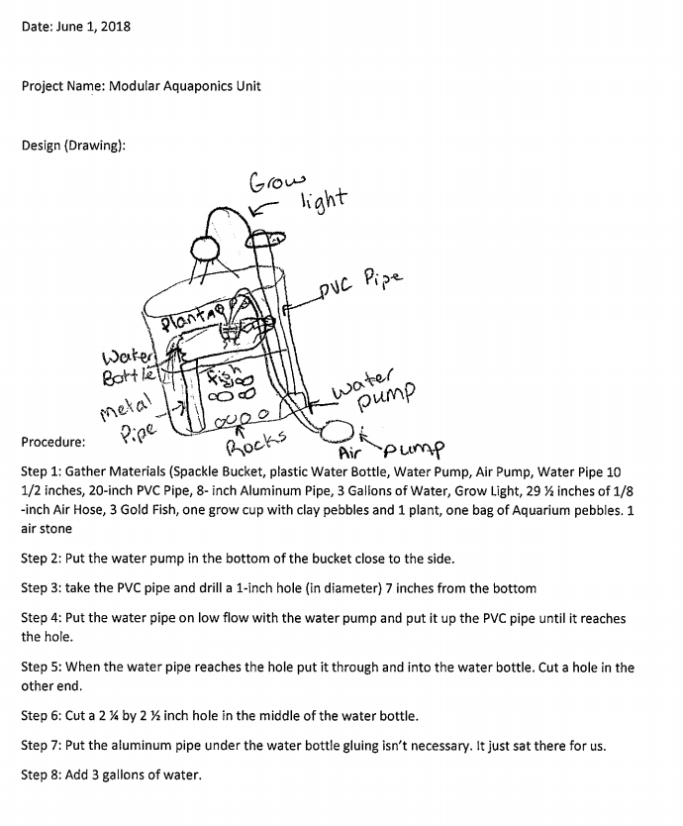

Slide 15
Design Thinking During Covid-19 Video on Resource Page

Slide 16
Growth Mindset

Slide 17
Design Process – Defining the Problem
What is the lived experience of those who are impacted? (Empathy)
How do you know? Have you asked?
What are the constraints?
Are there other problems that are related?
How do your talents/passions intersect with this problem?

Slide 18
Design Process - Brainstorming
List all possible solutions – even if they seem unrealistic.
Creativity is key here. Don’t limit yourself.
Research. Research. Research.
Have others solved similar problems?
Understand bias and reliable sources.

Slide 19
Design Process - Planning
Evaluation – What are the best ideas? How can ideas be combined to be most effective?
Research based – What research supports your intended plan?
Be explicit. Write down every step, and/or diagram your solution. Plan to collect data on the success of your solution.
Be mindful of you constraints. Ensure your plan can be implemented.
Focus on the lived experiences of those who will be affected. Try to see and mitigate unintended consequences of your plan.

Slide 20
Design Process - Implementation
It’s time to put your plan into action. Follow your plan.
Take meticulous notes. The more detail, the easier and more effective your reflection will be.
Constantly think about how your solution is impacting those who are affected by the problem. Empathy.
How are you measuring the success of your plan? You must collect data.

Slide 21
Design Process - Revision
Use the data you collected and the qualitative data (narrative) from those who are impacted to evaluate your plan. What went wrong? What was successful?
Identify and understand unintended consequences.
Once you’ve identified what went wrong, this becomes your new problem.
Start the process again, intentionally looking to improve.
Growth mindset.

Slide 22
Problems Of Practice
5 Groups – Each with a unique and current problem of practice (linked on resource page). Your work pages will be available for others to reference.
michaelsoskil.com/unknown
Go through the steps of the design process (adapted) to develop a possible solution.
Remember group norms (respect, empathy…). Keep your comments to 30-60 seconds.
Don’t get stuck on “yeah, but…” or kvetching. Maggie MacDonnell - “Don’t bring me problems, bring me solutions.”
Choose one person from your group will report your work (5 minutes max).

Slide 23
Sharing and Reflection on Problems of Practice

Slide 24
Goal Setting

Slide 25
Every problem in the world has a solution trapped inside our students’ passions.
Helping them see the connection
is our job as teachers.

Slide 26
Let’s Connect!
Twitter: @msoskil
Facebook: facebook.com/patoy2017
Website: michaelsoskil.com
Email: mrsoskil@gmail.com
Teaching in the Fourth Industrial Revolution: bit.ly/teaching4ir
New Book:
Flip the System US: How Teachers Can Transform Education and Save Democracy
Available this summer!

