Slide 1
Why Teachers Are More Important than Ever
Michael Soskil
2018 PA Teacher of the Year
Author/Editor of Flip the System US: How Teachers Can Transform Education and Save Democracy
mrsoskil@gmail.com

Slide 2
What is the purpose of public education?
@msoskil #FlipTheSystem

Slide 3
@msoskil #FlipTheSystem

Slide 4
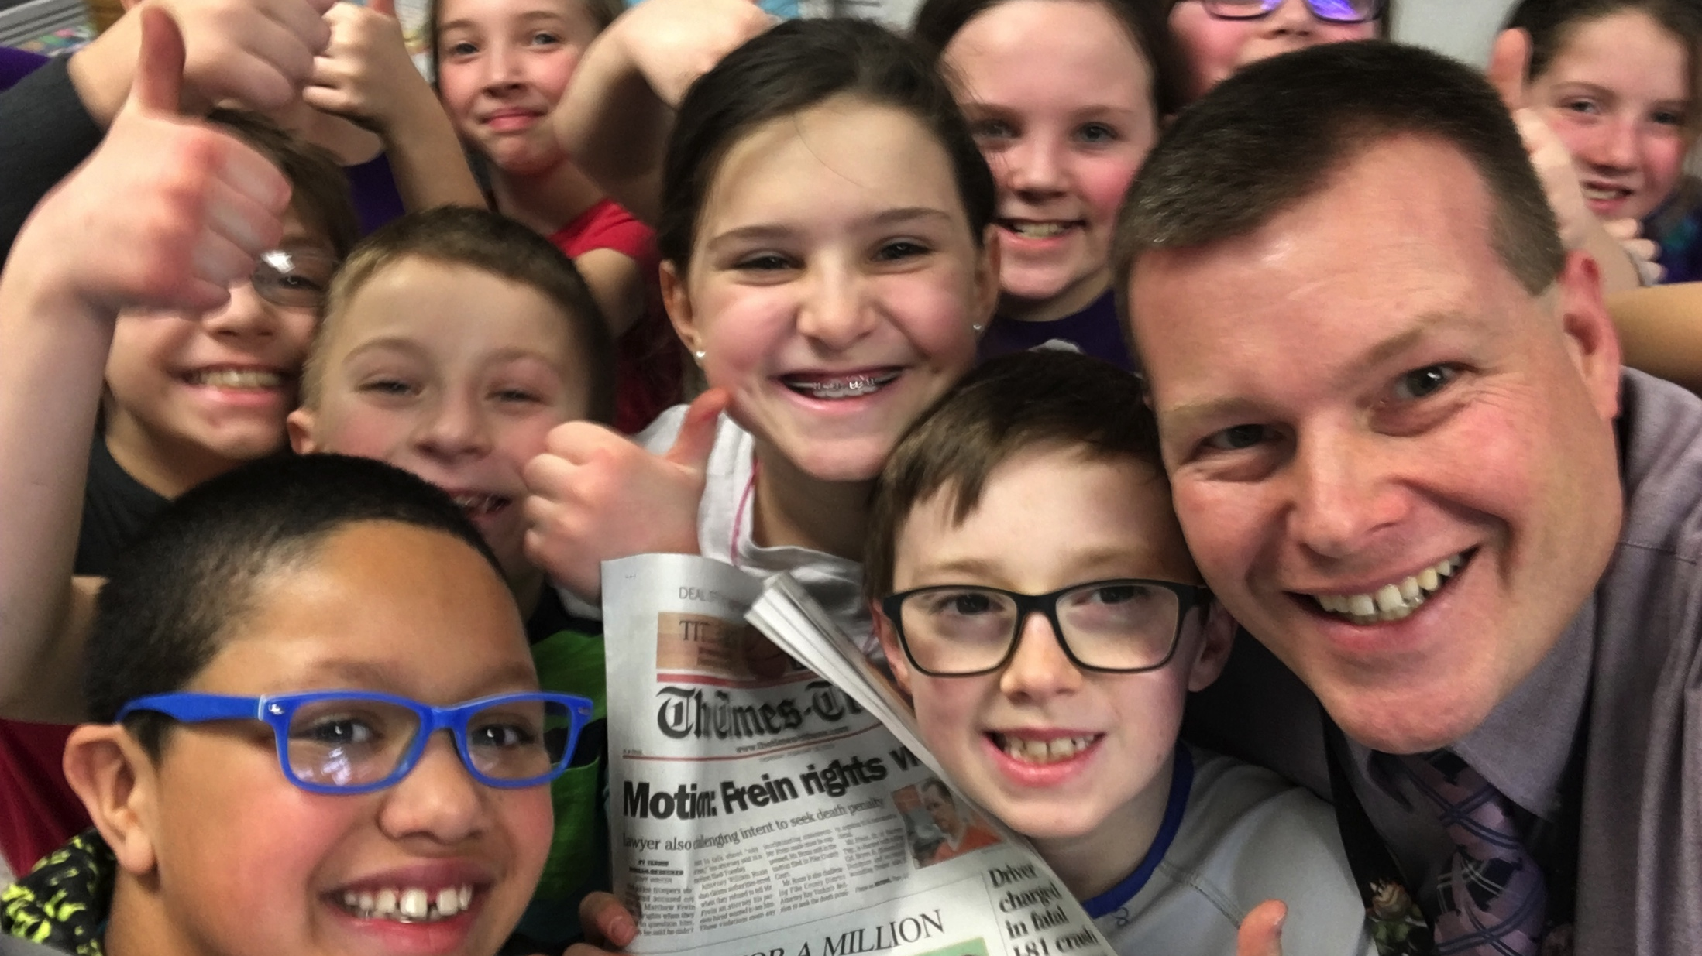
@msoskil #FlipTheSystem
Notes:
----- Meeting Notes (11/18/16 12:28) -----
The purpose of school is not to prepare kids for tests, colleges, or careers. The purpose of school is to give students the tools they need to be happy in their lives.

Slide 5
Project LINC: How I found my Why
@msoskil #FlipTheSystem

Slide 6
@msoskil #FlipTheSystem

Slide 7
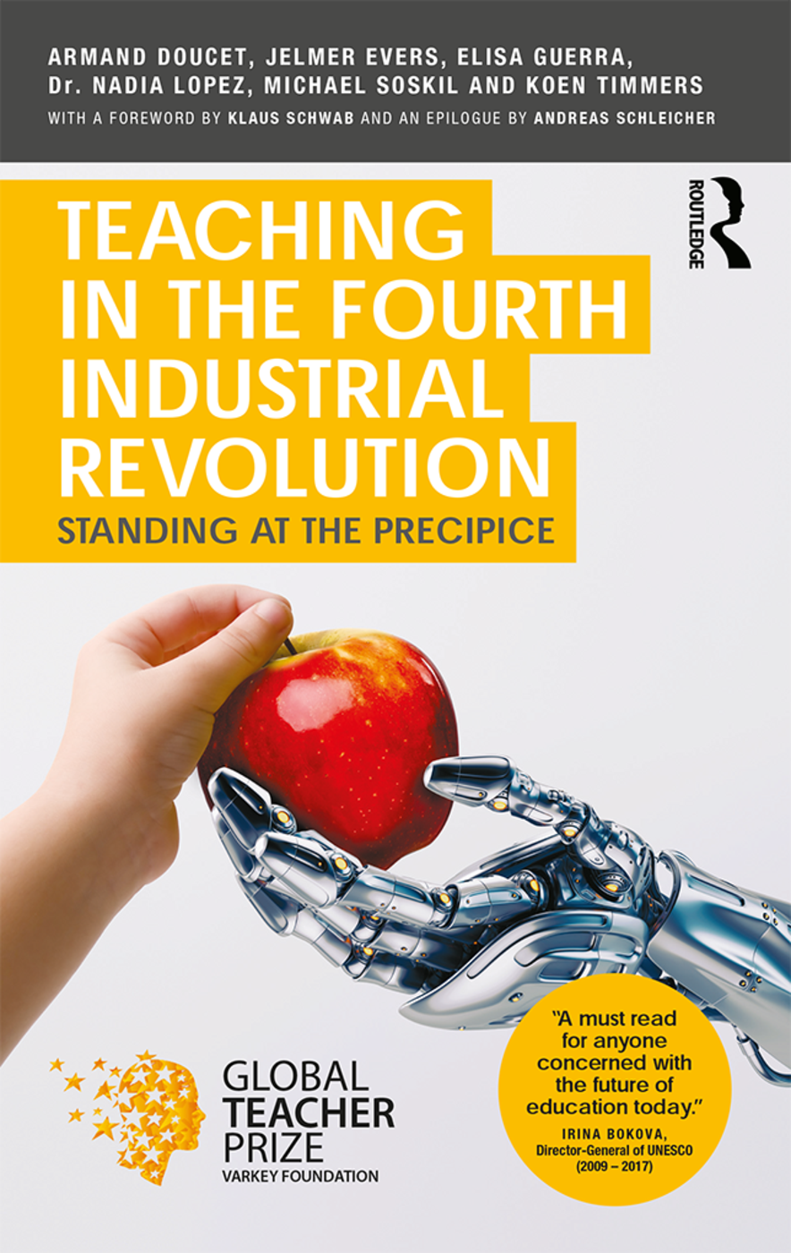
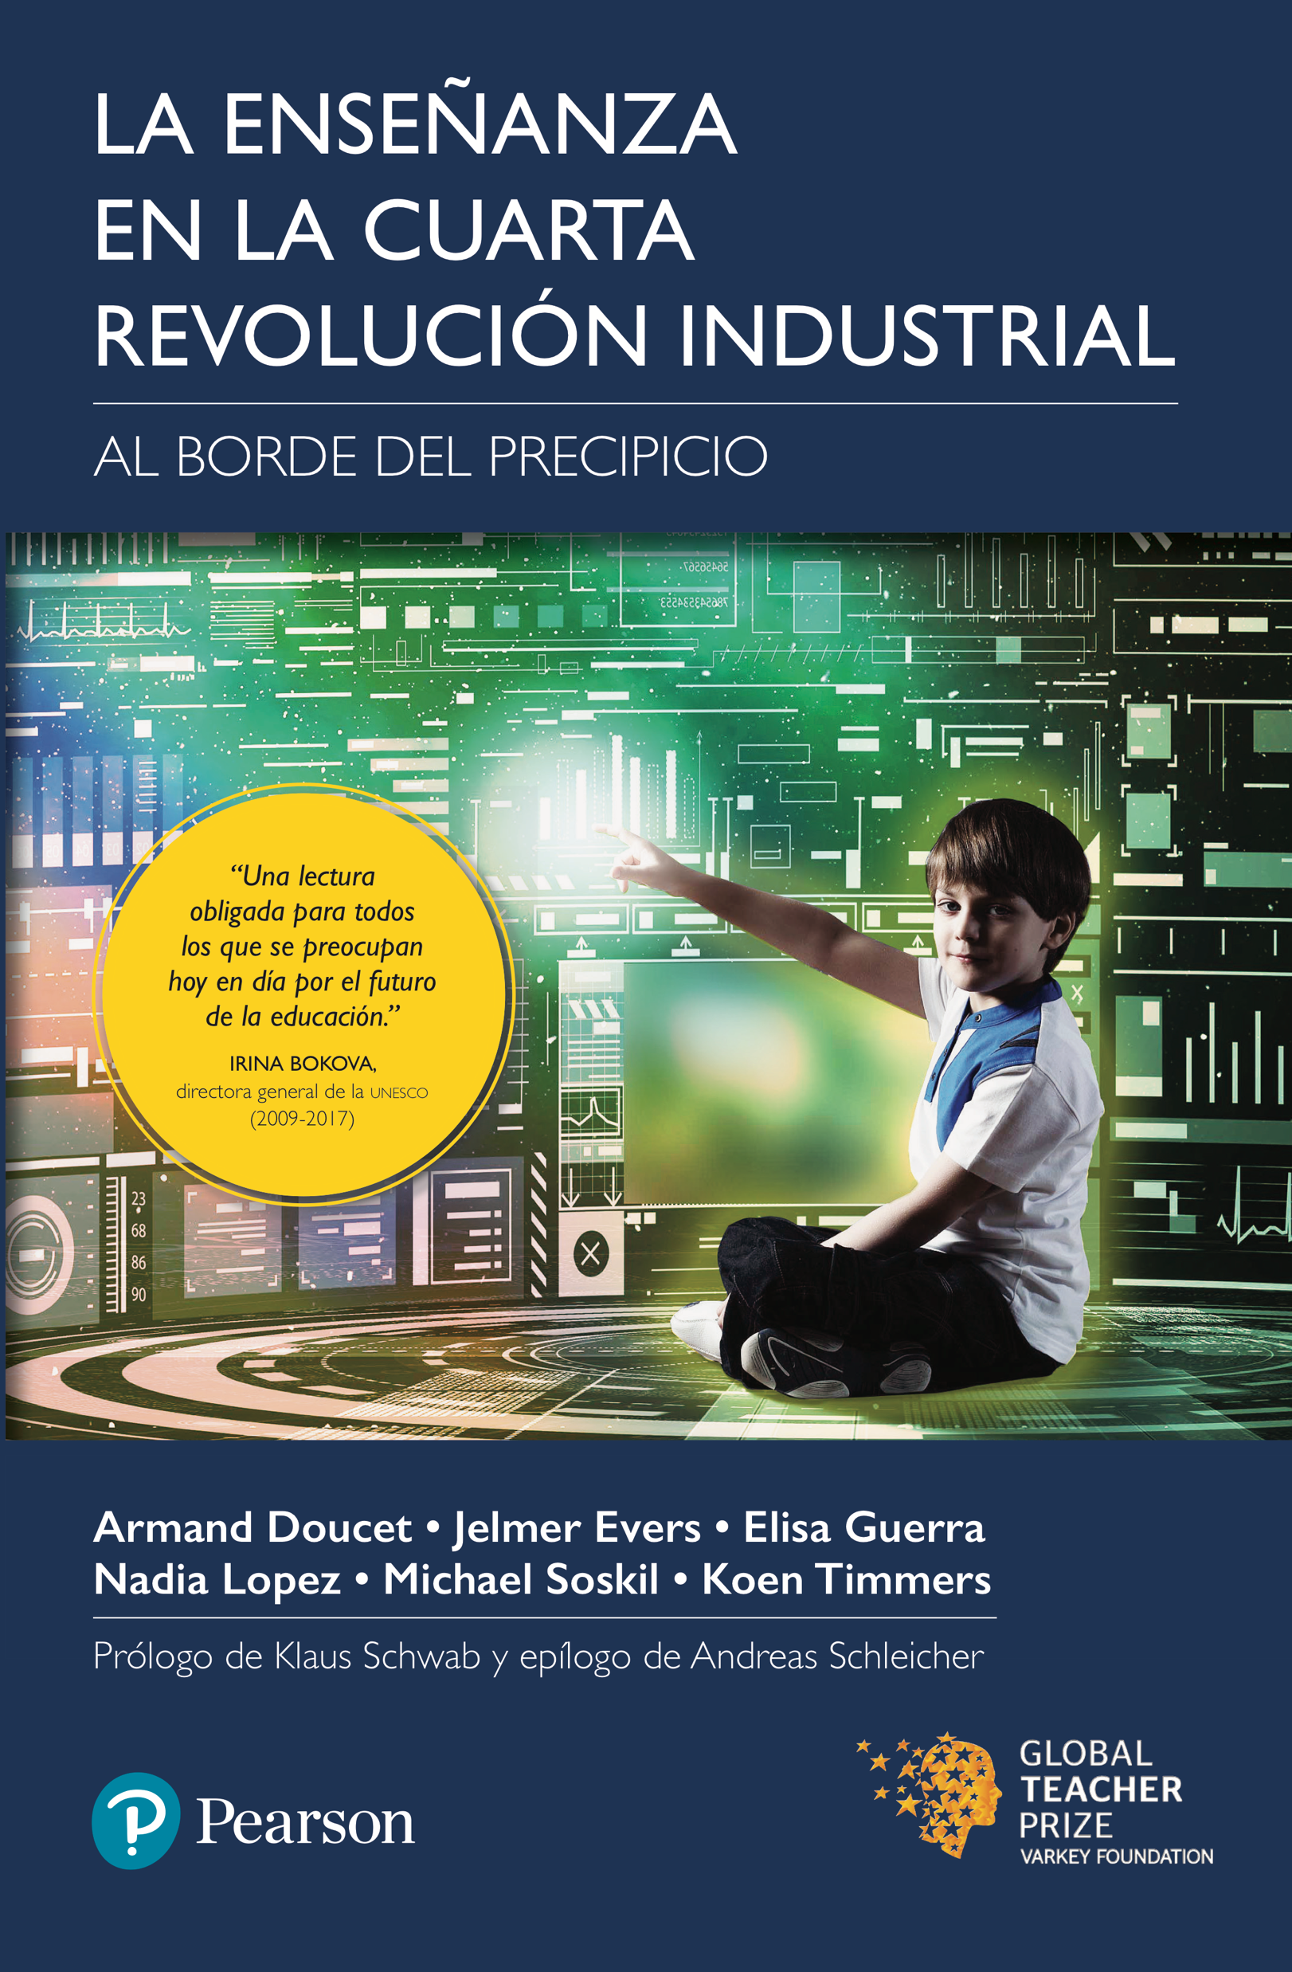
@msoskil #FlipTheSystem

Slide 8
Is public education supporting democracy? Is democracy supporting public education?
…”provide each student with the intellectual, emotional, and social growth necessary to become self-motivated, responsible, and caring citizens.”
@msoskil #FlipTheSystem

Slide 9
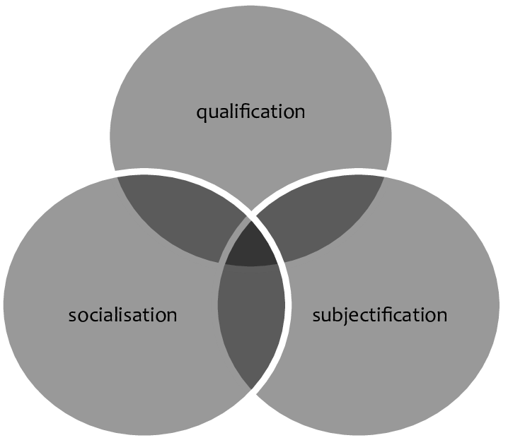
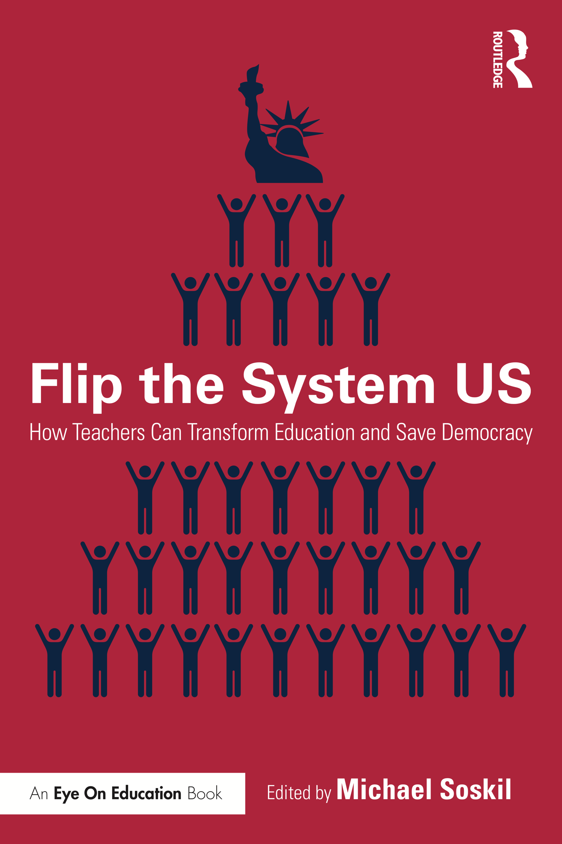
Gert Biesta: Education Model for Healthy Democratic Society
@msoskil #FlipTheSystem
Notes:
Explain the model Subjectification Last – Mental health and Suicide epidemic - Anchorage

Slide 10
Kasserian Ingera?
@msoskil #FlipTheSystem
Notes:
How are the children? All the children are well.

Slide 11
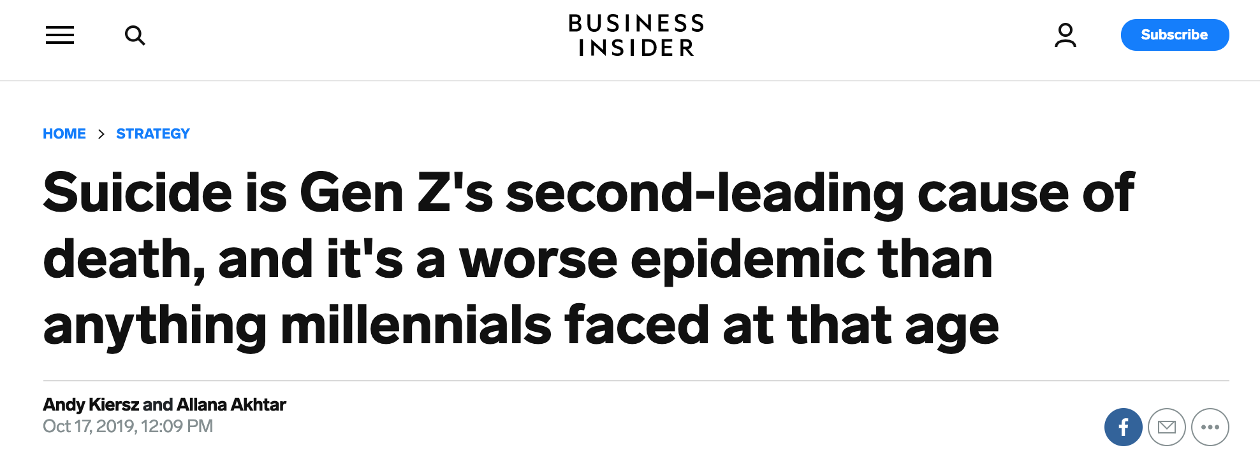
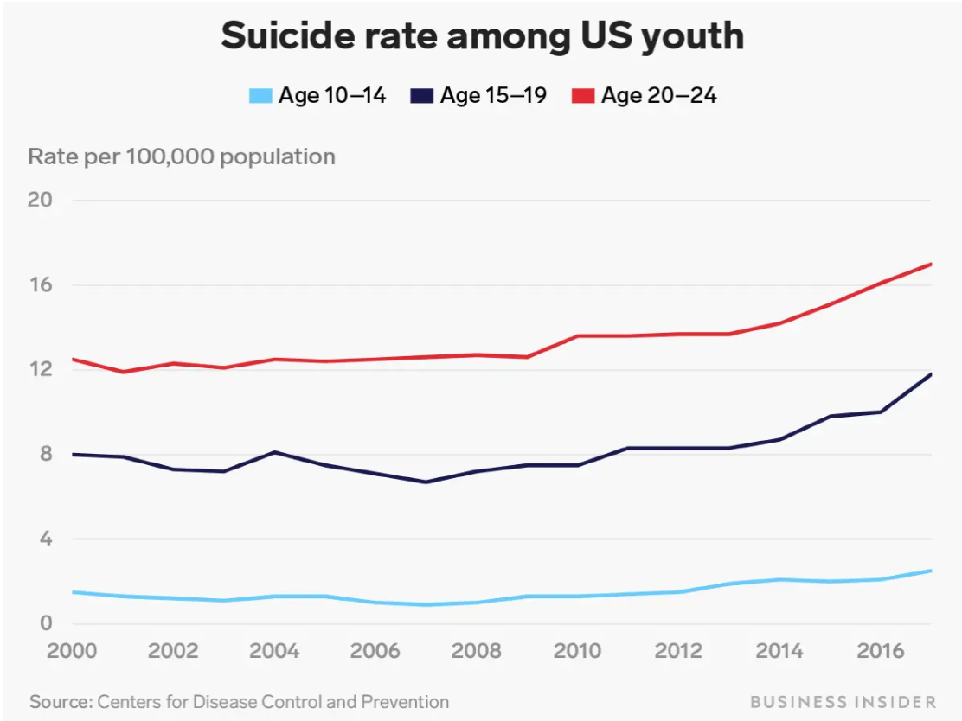
@msoskil #FlipTheSystem

Slide 12
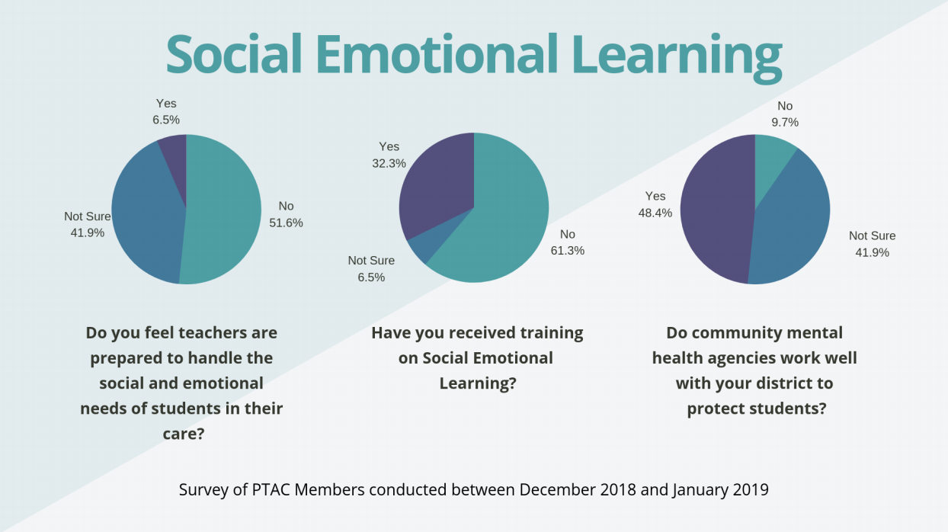
@msoskil #FlipTheSystem

Slide 13
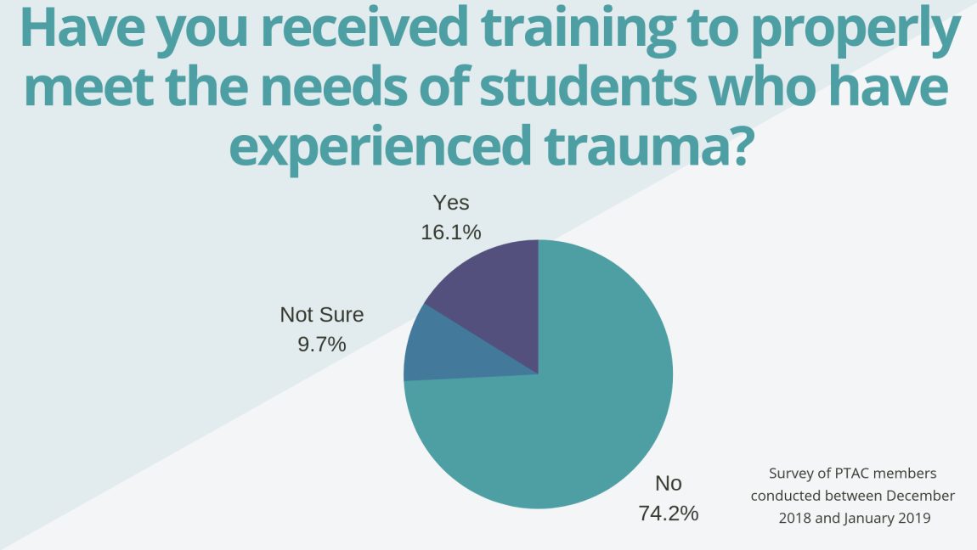
@msoskil #FlipTheSystem

Slide 14
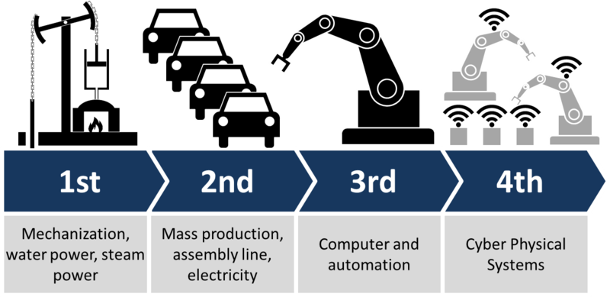
@msoskil #FlipTheSystem
Notes:
Ethical Dillemas – Chip in Brain, Cure Cancer, etc.

Slide 15
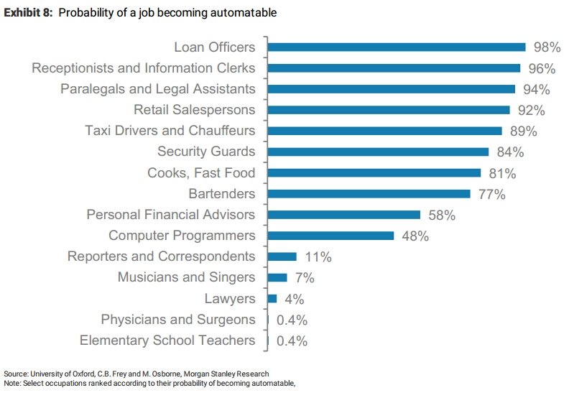

Slide 16
@msoskil #FlipTheSystem
Notes:
All royalties going to teacher development around the globe.

Slide 17
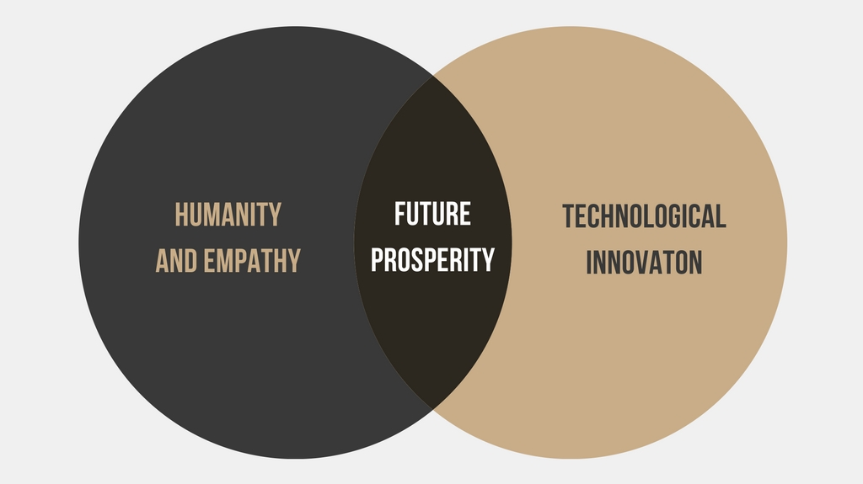
Photo Credit: Teaching in the Fourth Industrial Revolution, Chapter 1
@msoskil #FlipTheSystem

Slide 18
@msoskil #FlipTheSystem

Slide 19
Poverty vs. Inequality
Findings on societal inequality from The Spirit Level by Kate Pickett and Richard Wilkinson

Slide 20
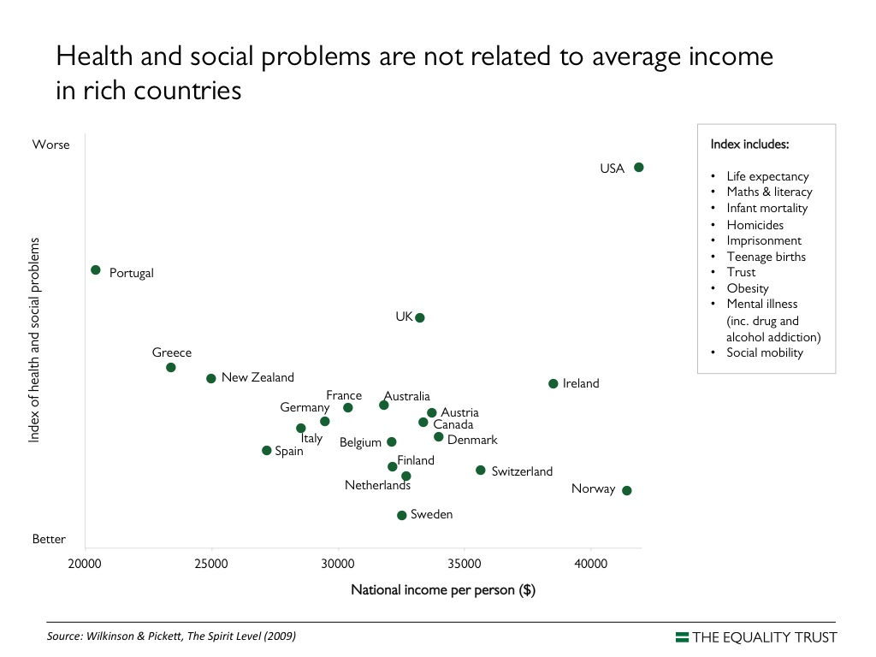

Slide 21
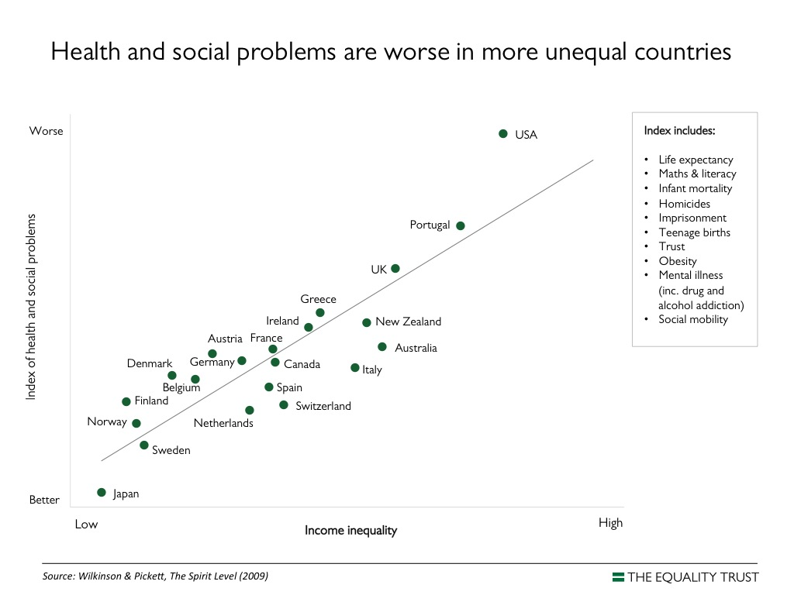

Slide 22
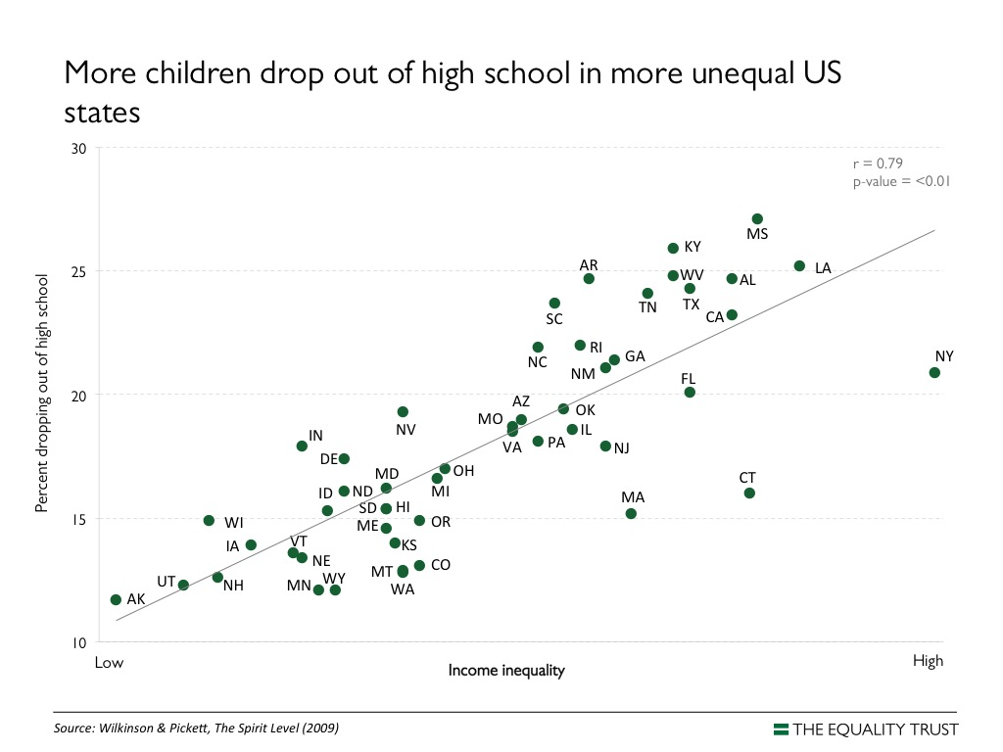

Slide 23
What character trait correlates most with success?
Emotional Intelligence (Empathy)
@msoskil #FlipTheSystem
Notes:
----- Meeting Notes (10/23/16 18:05) -----
Whether we define success as financial or personal happiness, research has shown that empathy correlates best with success in later life.
We must focus on this in schools.

Slide 24
Personalized Learning: Two Models
AI/Content Focus Model
Algorithms assess student learning and assign content based on student responses
Purchased program is implemented with fidelity to generate quantifiable data
Data and decisions are impersonal, based on spreadsheet
Teacher role is to facilitate technology
Student Centered/Relationship Model
Teachers leverage understanding of individual students to make decisions based on their needs
Heavy use of formative assessment to drive classroom decisions
Both quantitative and qualitative data are used to inform intervention
Teacher role is to build relationships and meet each student’s unique needs
@msoskil #FlipTheSystem

Slide 25
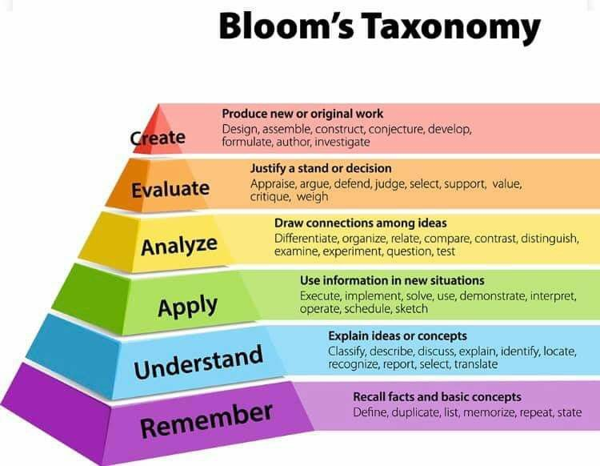
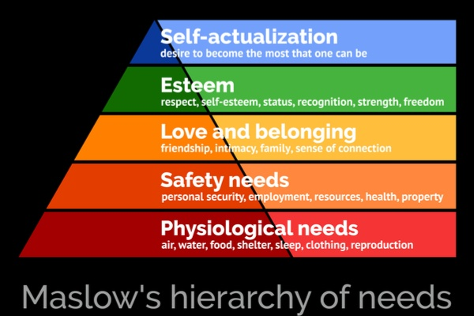
Maslow Before Bloom,
Bloom through Maslow
@msoskil #FlipTheSystem

Slide 26
SAMR Updated for the Fourth Industrial Revolution
Photo Credit: Teaching in the Fourth Industrial Revolution, Chapter 1
@msoskil #FlipTheSystem
Notes:
Fundraising, by itself, does not build empathy. Students need relationships with others who are different than they are.

Slide 27
It’s hard to change the world when you don’t know much about it.
@msoskil #FlipTheSystem

Slide 28
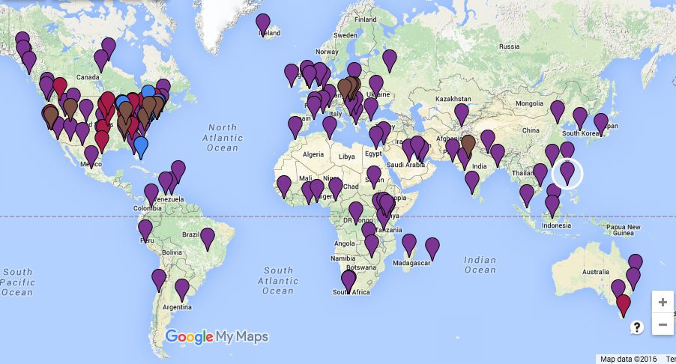
My Students’ Global Connections 2014-21: 100 Countries+
Song/Cultural Exchanges
Virtual Valentines
Exchange Video Messages
Data Collection in Collaborative Spreadsheets
Quadblogging
Slow Twitter Chat
Collaborative PBL Projects
Mystery Games
Virtual Teacher Exchange (guest teacher from another location)
Digital Post Cards
@msoskil #FlipTheSystem

Slide 29
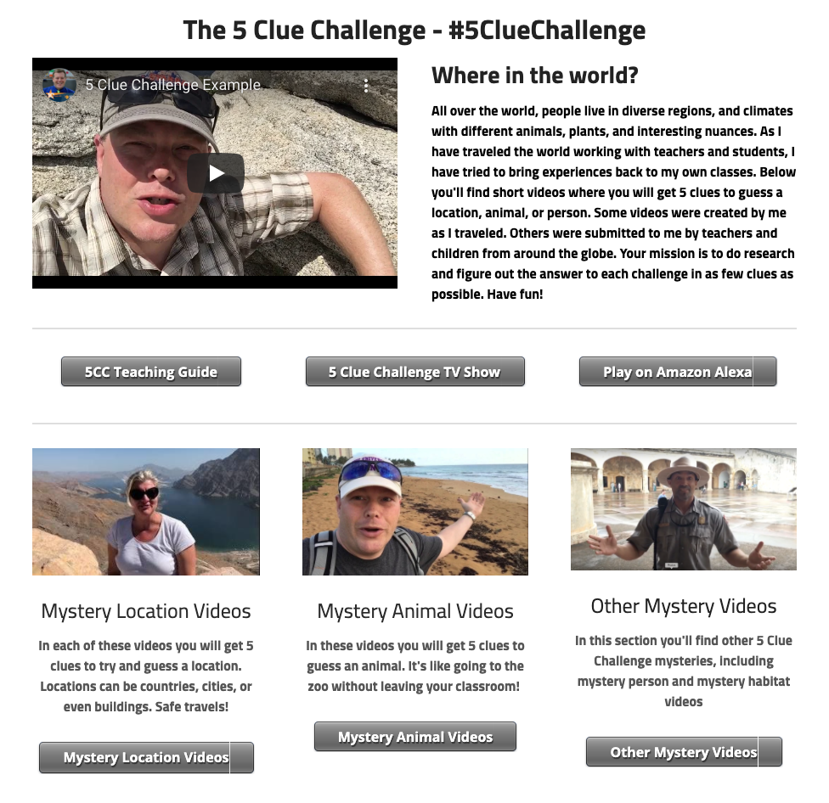
5 Clue Challenge
5ClueChallenge.com
@msoskil #FlipTheSystem

Slide 30
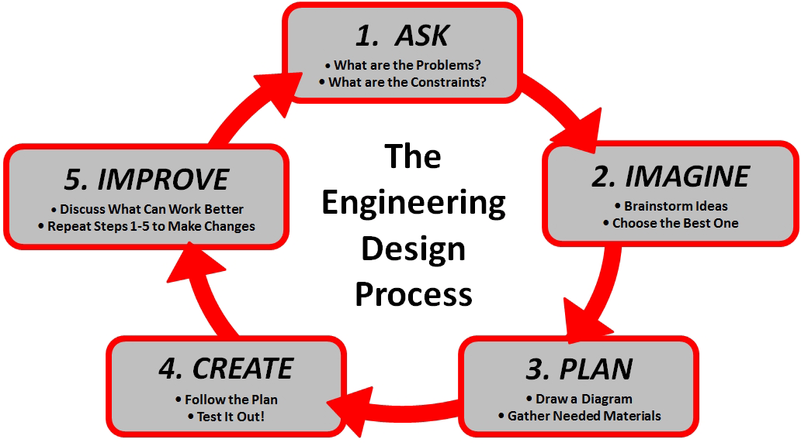
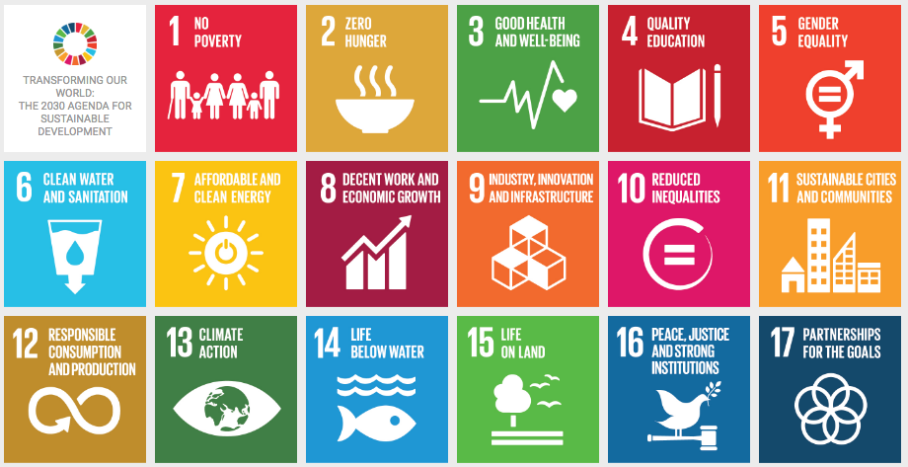
DESIGN THINKING AND UNITED NATIONS SDGS
SDGs Resources:
TeachSDGs.Org
WorldsLargestLesson.GlobalGoals.Org
InnovationSDGLab.com/book
@msoskil #FlipTheSystem
Notes:
----- Meeting Notes (10/23/16 18:05) -----
With that teaching philosophy, it's natural that the UN Sustainable Development Goals have been a focus in my career.
* NGO Advisor
*Almost every student's passion for making the world better can be tied to one of the UN SDGs.

Slide 31
Empatico.org
@msoskil #FlipTheSystem

Slide 32
Virtual Field Trips
Exploring by the Seat of Your Pants: exploringbytheseat.com
SkypeAScientist: skypeascientist.com
LivingMaths: livingmaths.com
Encounter EDU: encounteredu.com
Discovery Education: discoveryeducation.com/featured-programs
@msoskil #FlipTheSystem

Slide 33
Virtual Connections and Mystery Games
Similar to "20 Questions"
Each class takes turns asking Yes/No questions to figure out location of the other class.
Variations: animals, numbers, elements, occupations, etc. instead of locations.
Builds critical thinking skills and content knowledge.
Creates opportunities to connect with other locations to have Q&A sessions to find shared humanity.
@msoskil #FlipTheSystem

Slide 34
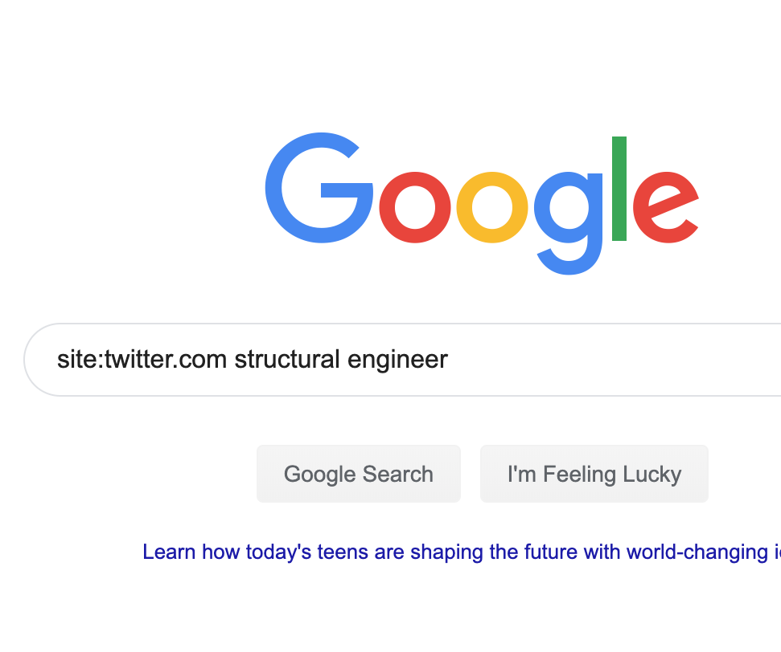
Mrs. Smoke’s Google Trick for Connecting with Experts @mrs_Smoke
@msoskil #FlipTheSystem

Slide 35
@msoskil #FlipTheSystem

Slide 36
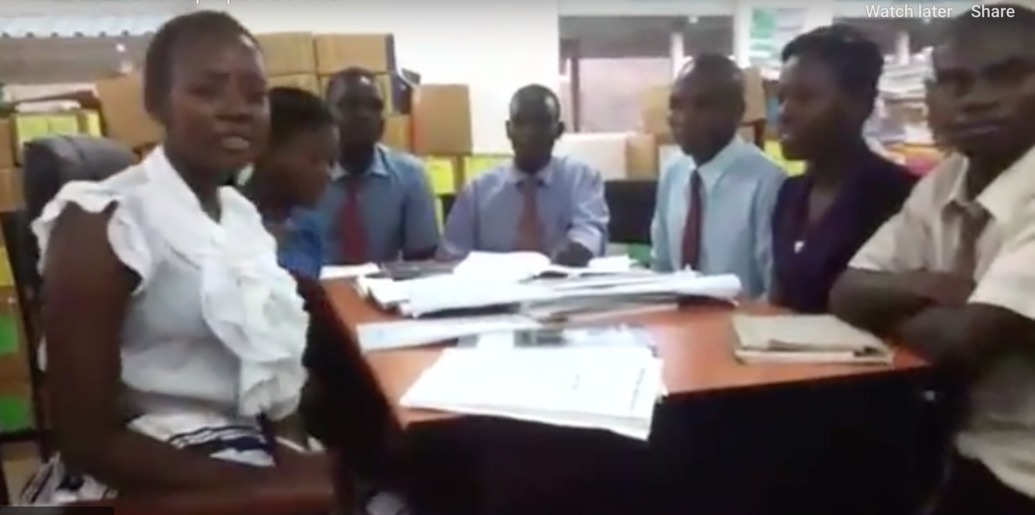
@msoskil #FlipTheSystem

Slide 37
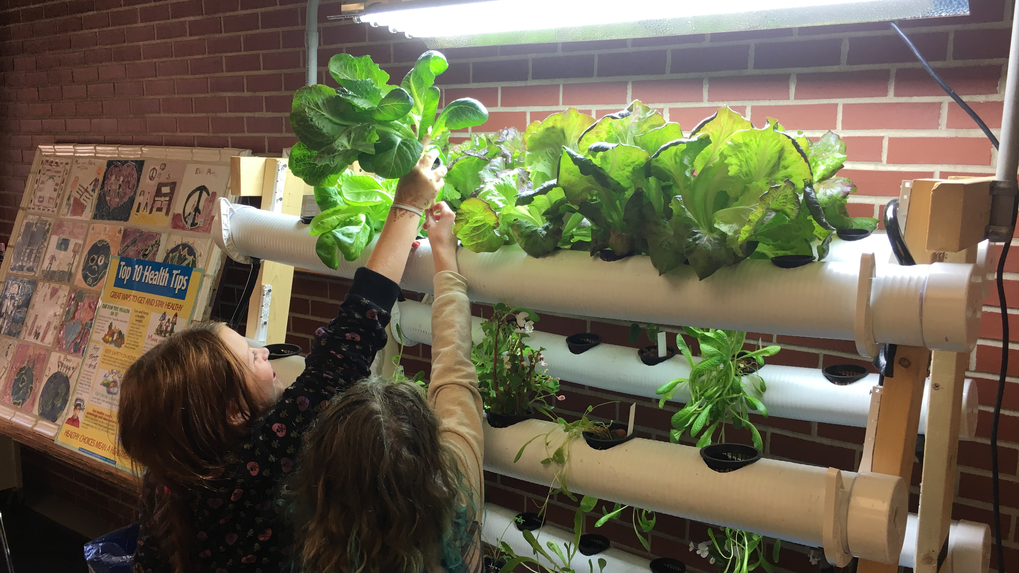
@msoskil #FlipTheSystem

Slide 38
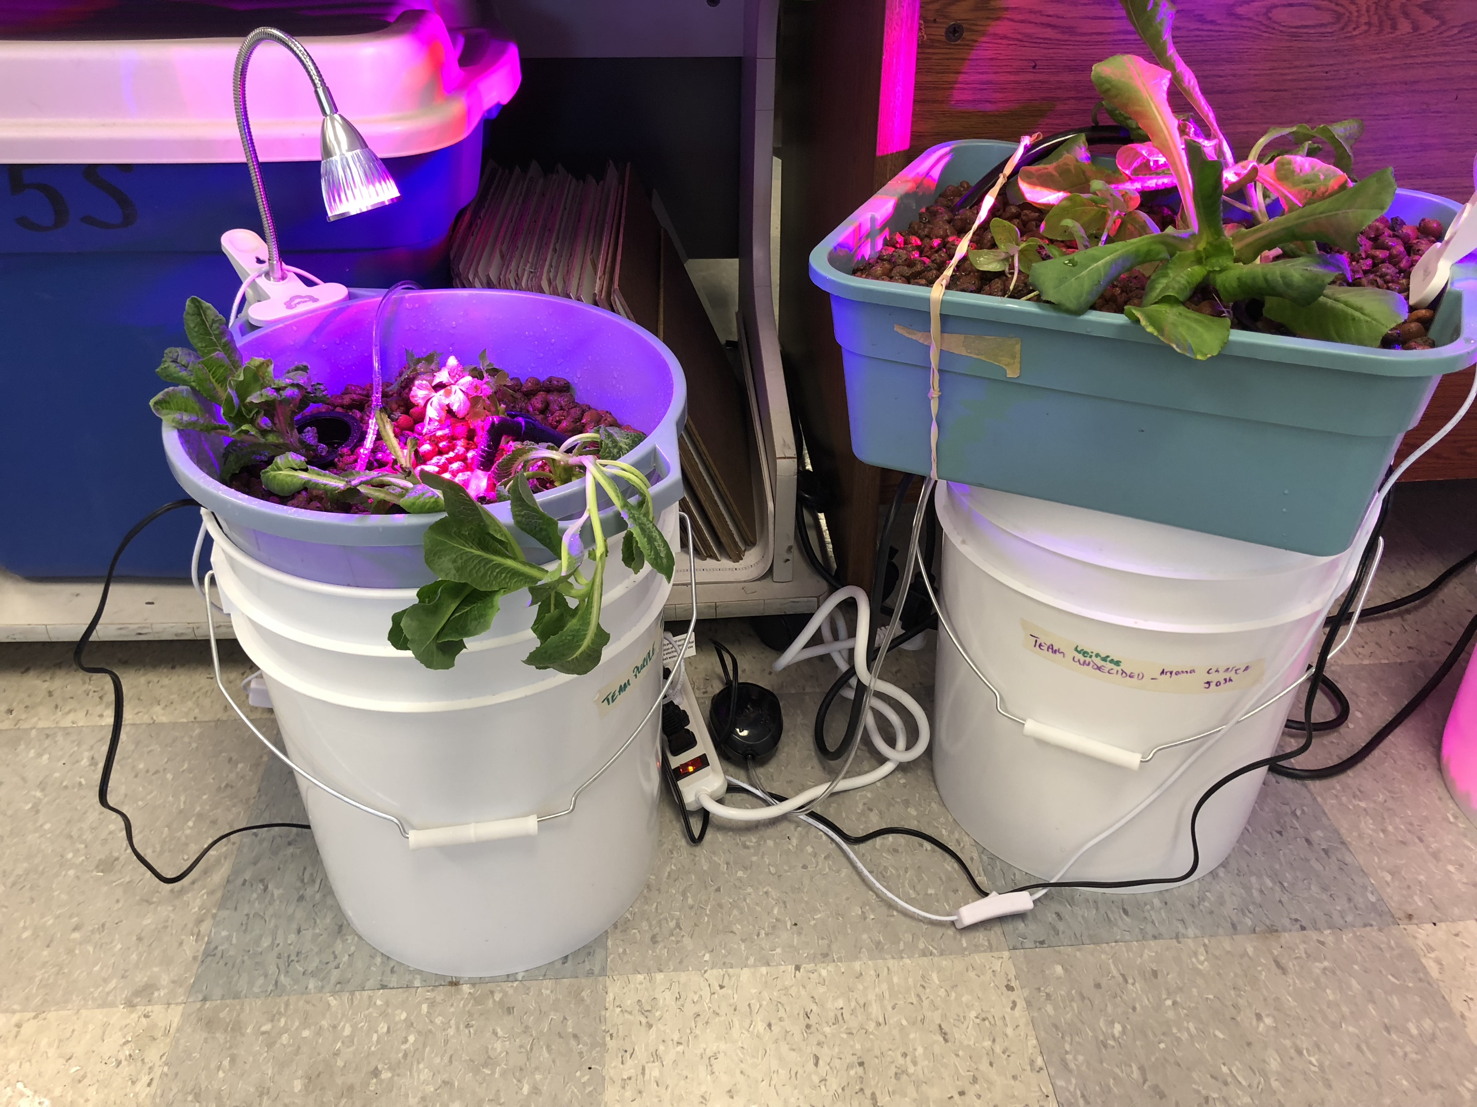
@msoskil #FlipTheSystem

Slide 39
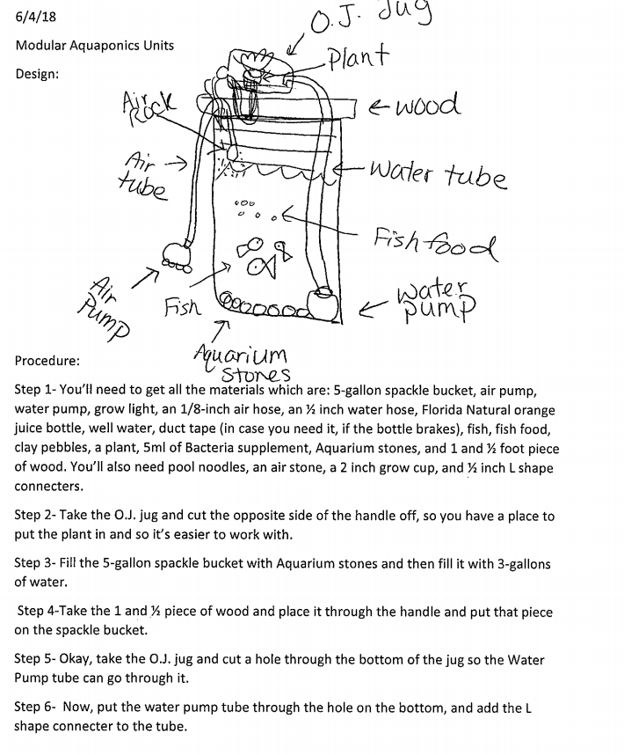
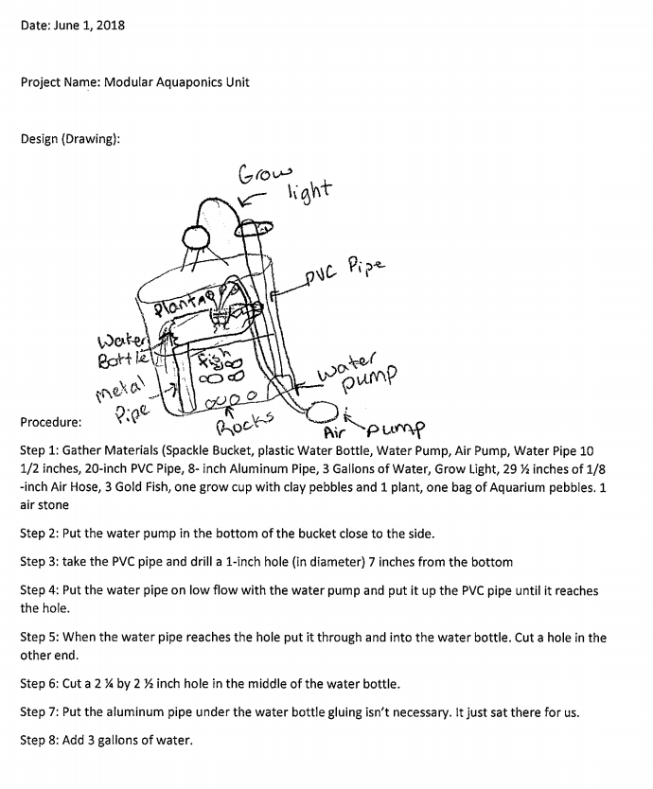
@msoskil #FlipTheSystem

Slide 40
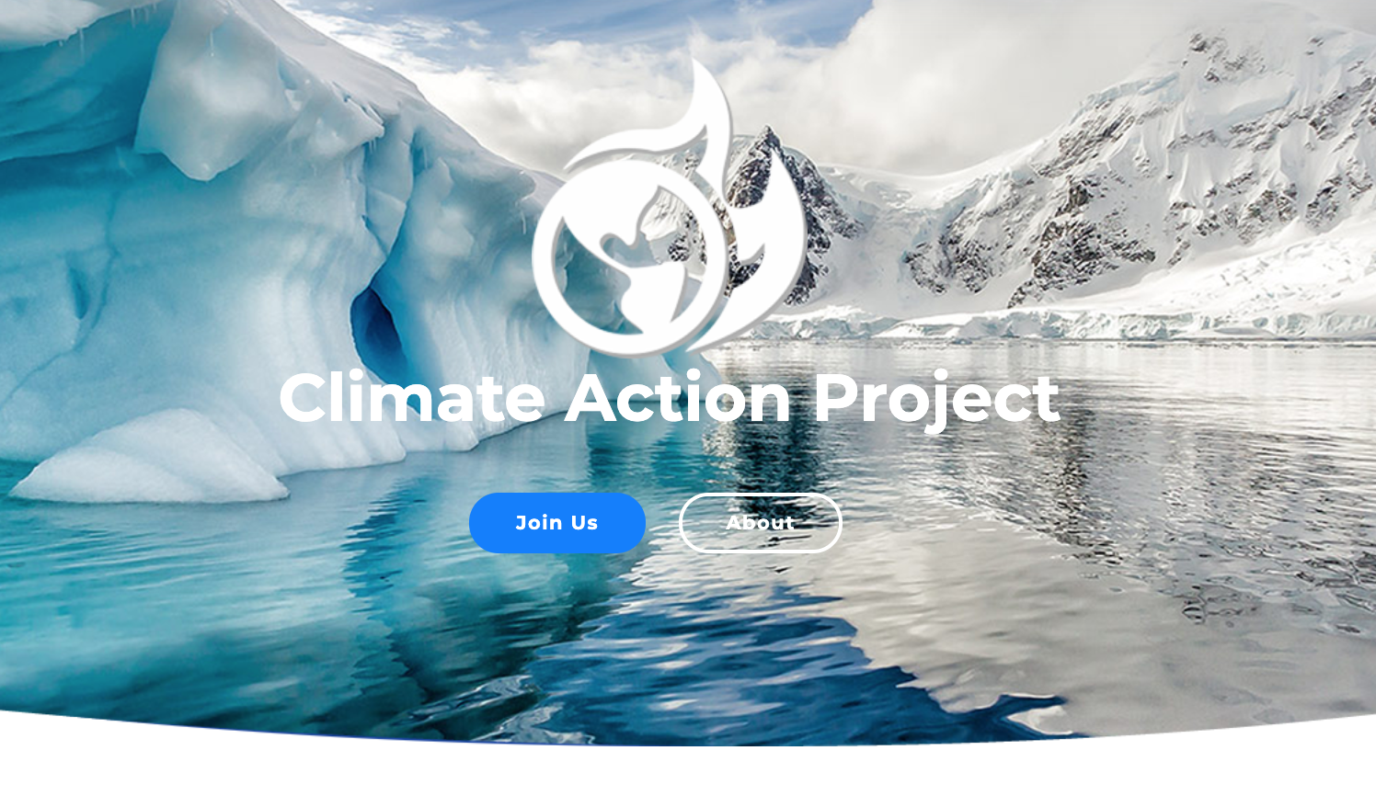
Climate-Action.Info
@msoskil #FlipTheSystem

Slide 41
@msoskil #FlipTheSystem

Slide 42
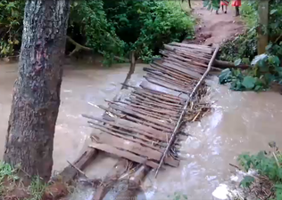
HIP Academy – Bungoma County Bridge Project
@msoskil #FlipTheSystem

Slide 43
The Magic Words “We should do something about that.”
@msoskil #FlipTheSystem

Slide 44
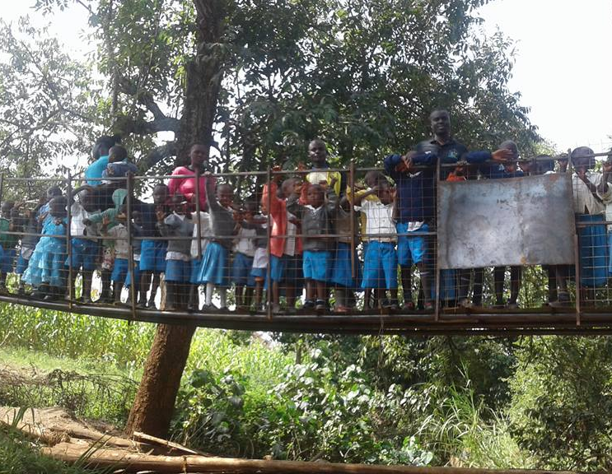
@msoskil #FlipTheSystem

Slide 45
Every problem in the world has a solution locked inside our students’ passions. Our job is to give them the keys.
@msoskil #FlipTheSystem

Slide 46
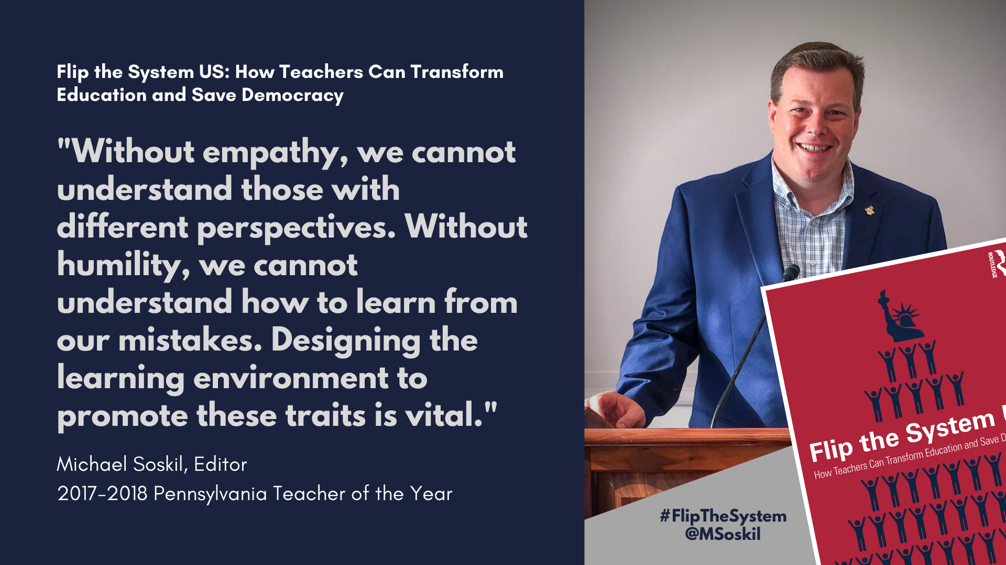
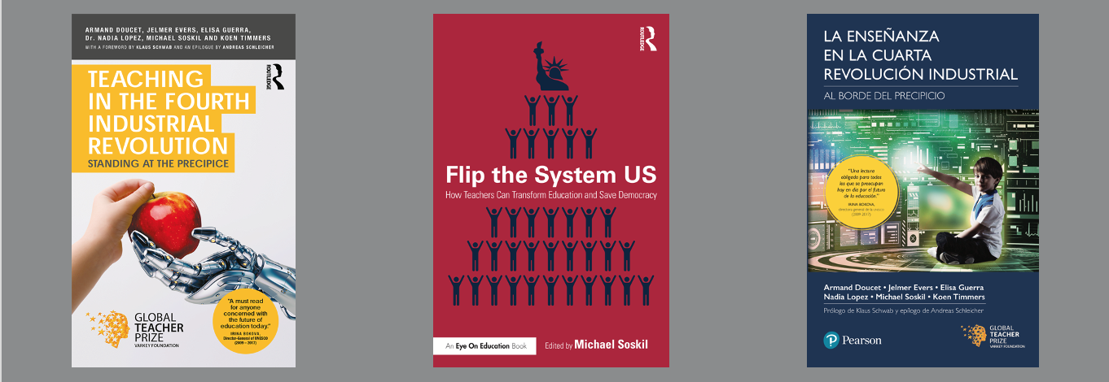
Connect with Me
Email: mrsoskil@gmail.com
Twitter: @msoskil
Books, teacher training, resources, and more information: michaelsoskil.com
Get the slides and resources:
MichaelSoskil.com/Dwight

